Slide 1
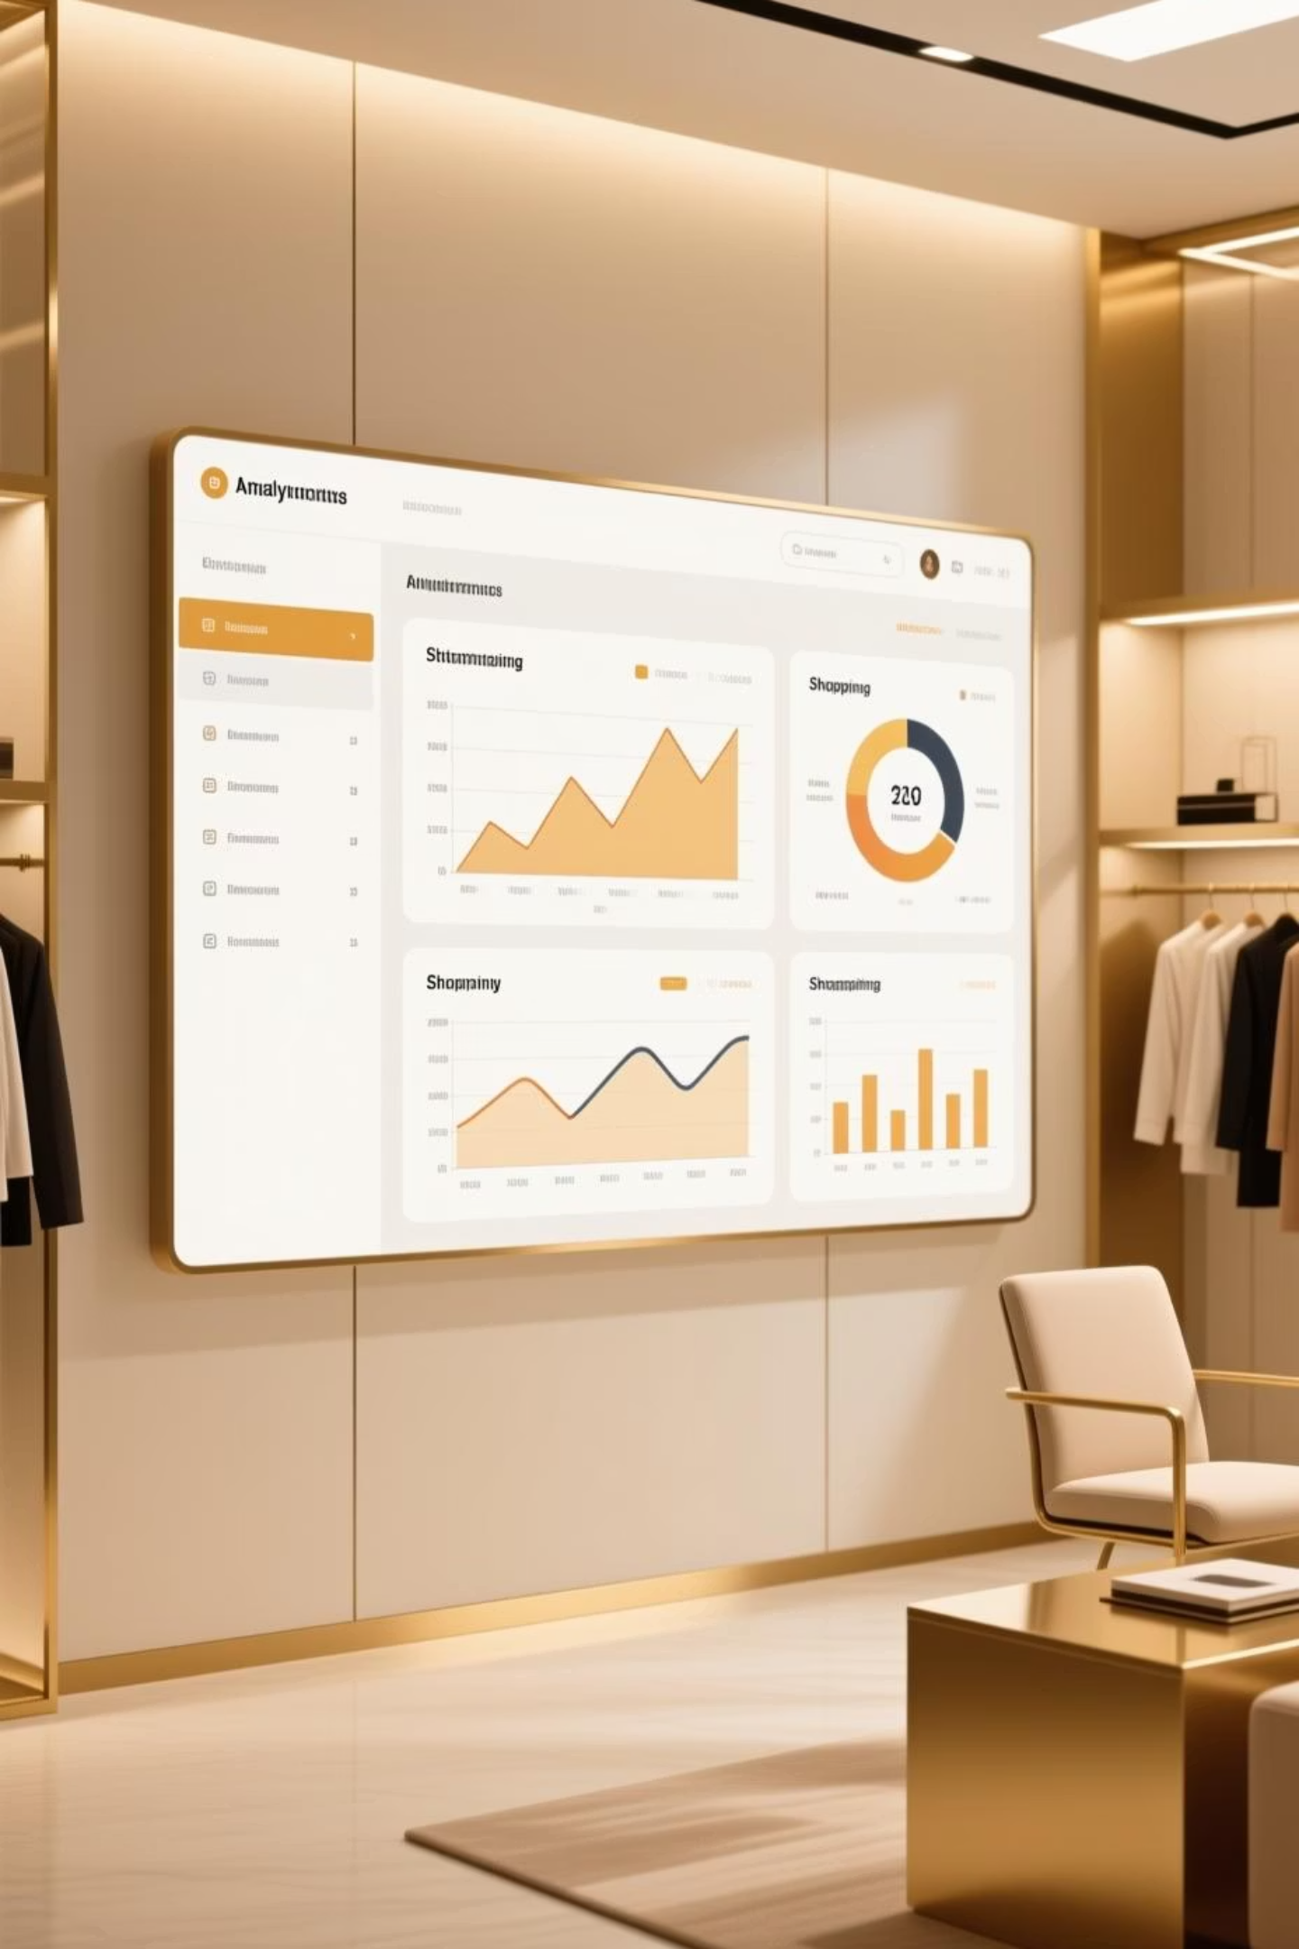
Customer Shopping Behavior Analysis
Analyzing 3,900 purchases to uncover insights into spending patterns, customer segments, and product preferences that drive strategic business decisions.

Slide 2
Dataset Overview
3,900
18
50
25
Total Purchases
Data Columns
Locations
Products
Transactions analyzed across all categories
Features covering demographics and behavior
Geographic distribution of customers
Unique items purchased
Key features include customer demographics, purchase details, shopping behavior patterns, and review ratings. Only 37 missing values found in Review Rating column.

Slide 3
Data Preparation Process
01
02
Data Loading & Exploration
Missing Data Handling
Imported dataset using pandas and analyzed structure with df.info() and summary statistics
Imputed 37 missing Review Rating values using median rating by product category
03
04
Feature Engineering
Database Integration
Created age_group bins and purchase_frequency_days columns for deeper analysis
Connected to PostgreSQL and loaded cleaned data for SQL business analysis

Slide 4
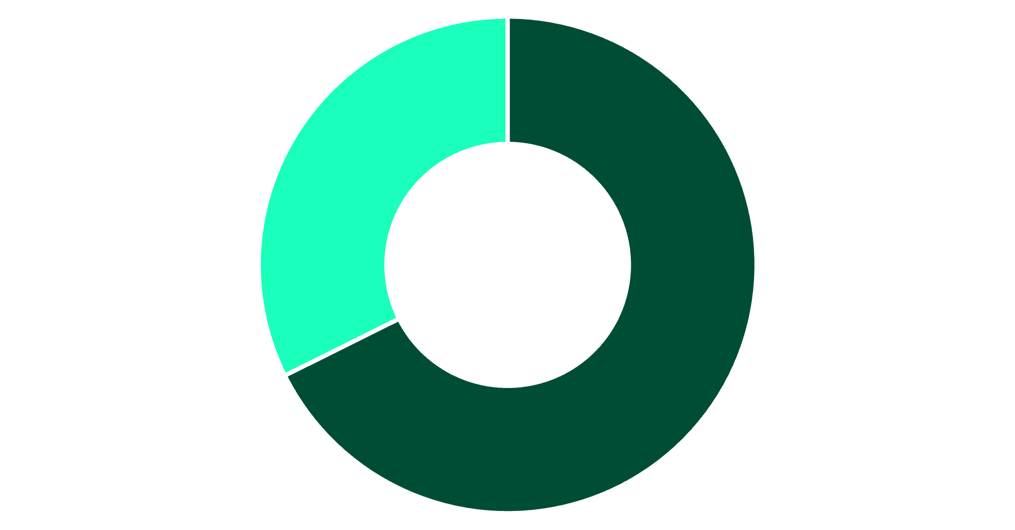
Revenue by Gender
Male Customers Drive Revenue
Male customers generated $157,890 in total revenue compared to $75,191 from female customers—representing 68% of total sales.
This significant gap suggests opportunities for targeted marketing to female demographics.
Male
Female

Slide 5


Customer Spending Insights
High-Value Discount Users
Shipping Preferences
Subscription Impact
839 customers used discounts but still spent above average ($59.76), indicating price-conscious yet high-spending segments.
Express shipping customers spend $60.48 on average vs. $58.46 for Standard—a 3.5% premium for faster delivery.
Subscribers and non-subscribers show similar average spend ($59.49 vs. $59.87), but non-subscribers drive 73% of total revenue.

Slide 6
Top-Rated Products
77%
77%
76%
Gloves
Sandals
Boots
Highest average rating at 3.86 out of 5.0
Strong performance with 3.84 rating
Solid customer satisfaction at 3.82
76%
76%
Hat
Skirt
Consistent quality with 3.80 rating
Rounds out top 5 at 3.78 rating
These products demonstrate consistent quality and customer satisfaction, making them ideal for promotional campaigns and inventory prioritization.

Slide 7



Customer Segmentation Analysis
Loyalty Dominates
80% of customers are classified as Loyal based on purchase history, indicating strong retention.
Among repeat buyers (5+ purchases), 958 are subscribers while 2,518 are not—suggesting untapped subscription potential.
New
83 customers
Returning
701 customers
Loyal
3,116 customers

Slide 8
Discount-Dependent Products
1
2
3
Hat
Sneakers
Coat
50% of purchases used discounts
49.66% discount rate
49.07% discount rate
4
5
Sweater
Pants
48.17% discount rate
47.37% discount rate
These products rely heavily on discounts to drive sales. Review pricing strategy to balance volume with profit margins.

Slide 9
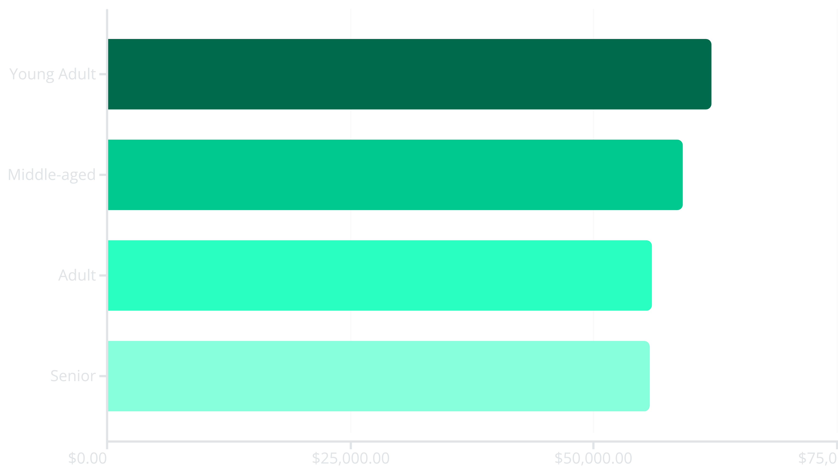
Revenue by Age Group
Young Adults lead revenue generation at $62,143, followed closely by Middle-aged customers. Revenue distribution is relatively balanced across age groups, suggesting broad market appeal.

Slide 10
Strategic Recommendations
Boost Subscriptions
Loyalty Programs
Promote exclusive benefits to convert the 2,518 repeat buyers who aren't yet subscribers.
Reward repeat buyers to strengthen the 80% loyal customer base and increase lifetime value.
Review Discount Policy
Targeted Marketing
Balance promotional discounts with margin control, especially for the 5 discount-dependent products.
Focus campaigns on Young Adults, express-shipping users, and top-rated products like Gloves and Sandals.

